Slide 1
Capital One Seat Tracker Application
Hari Kishan Dande Capital One UK
Notes:
The below and following notes on the template slides are to guide you only. In your final presentation, you may delete these notes and add relevant notes if any.
Title slide:
Title – should not exceed beyond 3 lines, font size 30-34, Arial Bold
(Font size for the title of the PPT can vary between 30-34, Arial, Bold depending on the amount of text, however should not be smaller than 30 font size)
Name should not exceed beyond 1 line, Designation; font size to remain at 16, Arial normal
Please keep the title slide simple, just the logo, title and name and designation to appear. No other graphic elements or any design, photograph, image can be added to this slide, alignment to remain the same

Slide 2
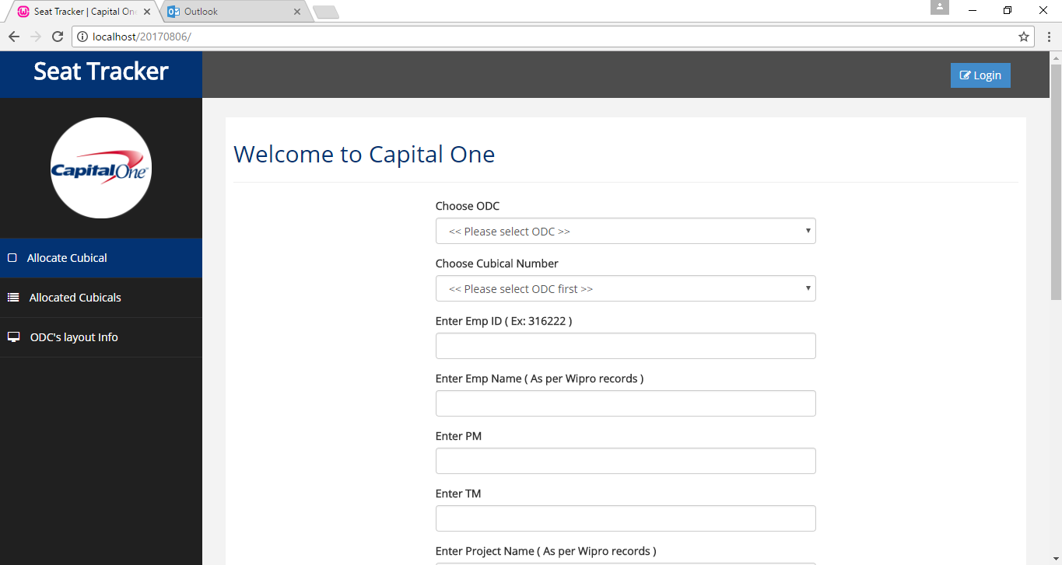
1. This is home page for every capital one user to allocate a cubical to their name.
Notes:
Blank slide or a freeform slide you may use this to insert or show screenshots etc
If content is added in this slide you will need to use bulleted text

Slide 3
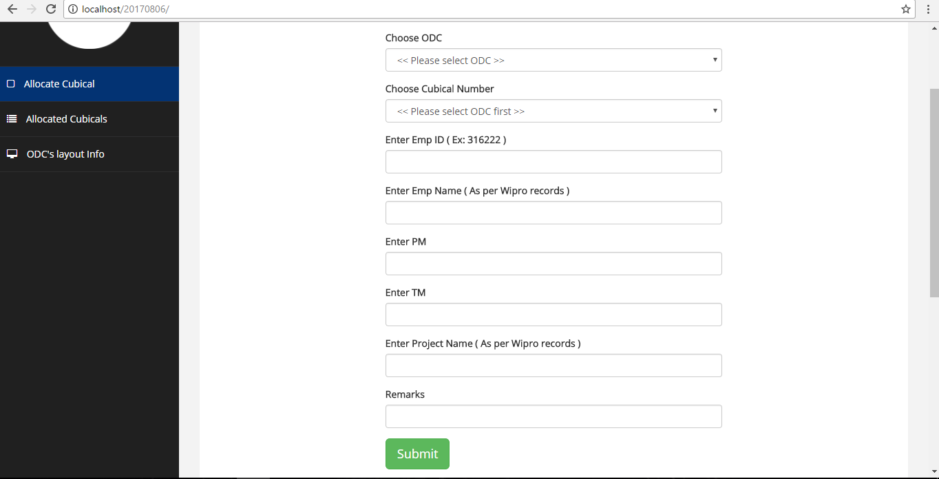
2. Below are the complete required details to occupy a cubical; except remarks all are mandatory fields.
Notes:
Content Slide: This is usually the most frequently used slide in every presentation.
Use this slide for Text heavy slides. Text can only be used in bullet points
Title Heading – font size 30, Arial bold
Slide Content – Should not reduce beyond Arial font 16
If you need to use sub bullets please use the indent buttons located next to the bullets buttons in the tool bar and this will automatically provide you with the second, third, fourth & fifth level bullet styles and font sizes
Please note you can also press the tab key to create the different levels of bulleted content

Slide 4
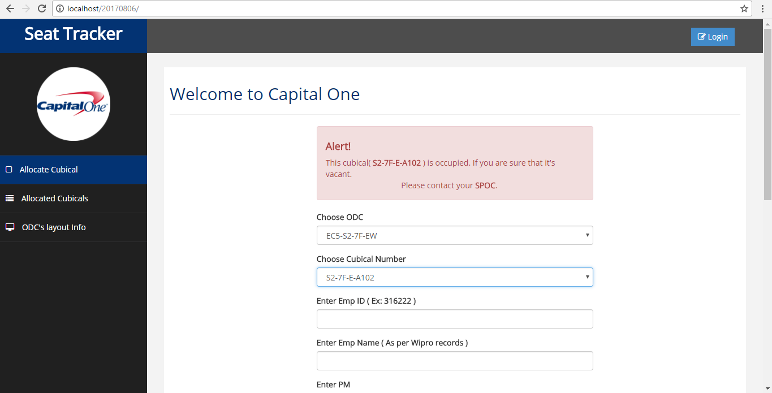
3. After ODC selection, one specific cubical has to be selected by the user. If the cubical is occupied, it will be notified as shown below.
Notes:
Blank slide or a freeform slide you may use this to insert or show screenshots etc
If content is added in this slide you will need to use bulleted text

Slide 5
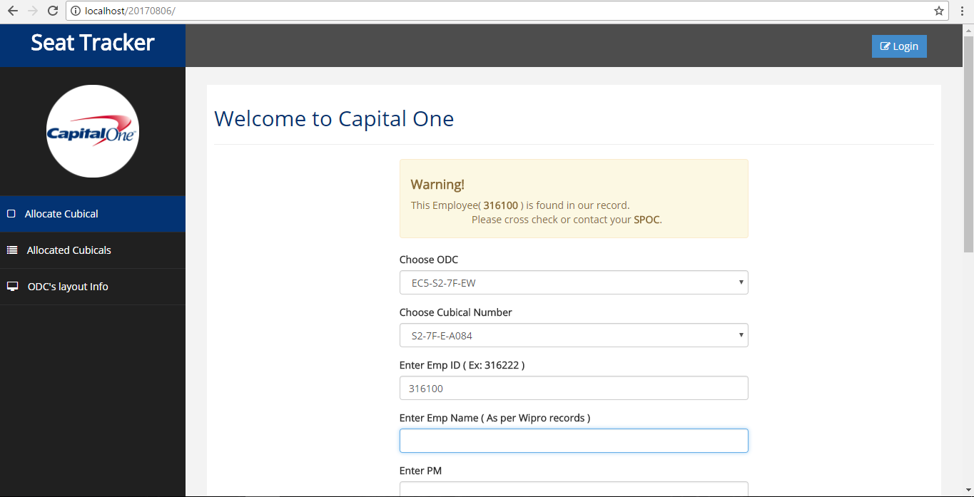
5. If the user is already having an entry in the ODC records, he/she can’t proceed, as a single employee can’t occupy multiple cubicles.
Notes:
Content Slide: This is usually the most frequently used slide in every presentation.
Use this slide for Text heavy slides. Text can only be used in bullet points
Title Heading – font size 30, Arial bold
Slide Content – Should not reduce beyond Arial font 16
If you need to use sub bullets please use the indent buttons located next to the bullets buttons in the tool bar and this will automatically provide you with the second, third, fourth & fifth level bullet styles and font sizes
Please note you can also press the tab key to create the different levels of bulleted content

Slide 6
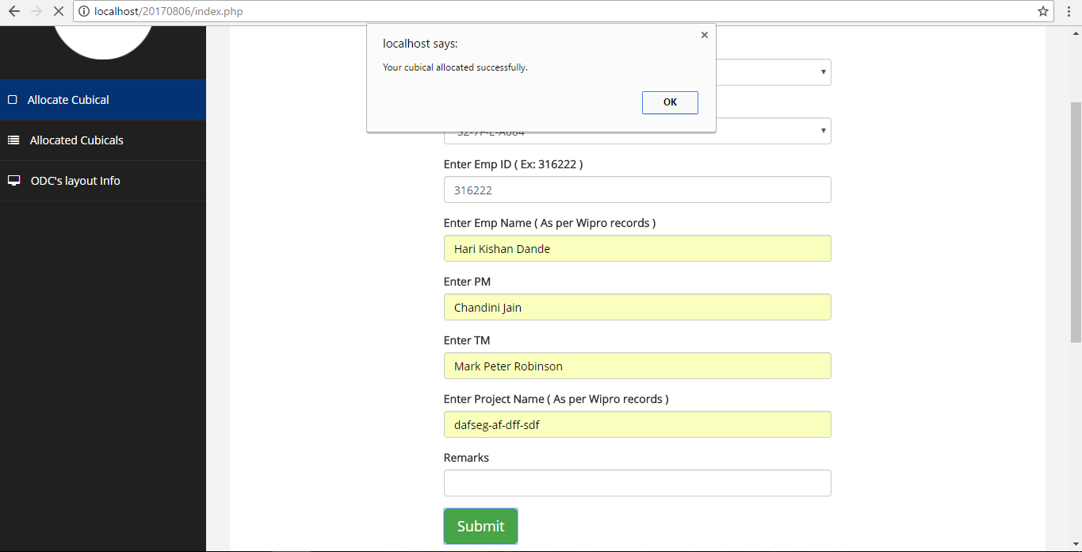
6. In below, the user has been successfully allocated to a cubical number.
Notes:
Blank slide or a freeform slide you may use this to insert or show screenshots etc
If content is added in this slide you will need to use bulleted text

Slide 7
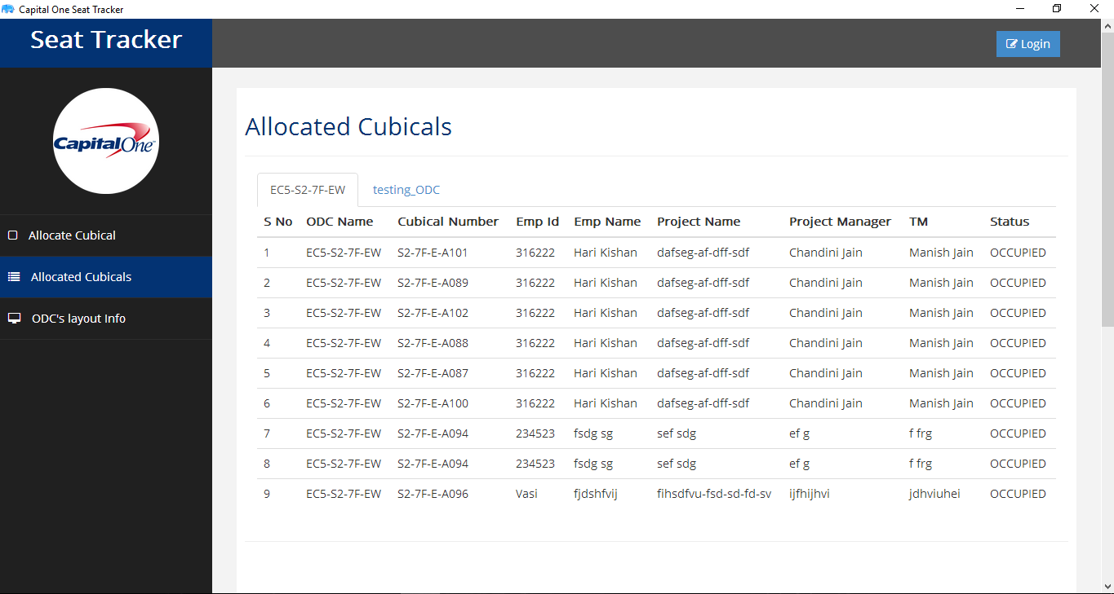
7. After cubical occupancy, employees can cross check their details in “Allocated cubicles” tab.
Notes:
Content Slide: This is usually the most frequently used slide in every presentation.
Use this slide for Text heavy slides. Text can only be used in bullet points
Title Heading – font size 30, Arial bold
Slide Content – Should not reduce beyond Arial font 16
If you need to use sub bullets please use the indent buttons located next to the bullets buttons in the tool bar and this will automatically provide you with the second, third, fourth & fifth level bullet styles and font sizes
Please note you can also press the tab key to create the different levels of bulleted content

Slide 8
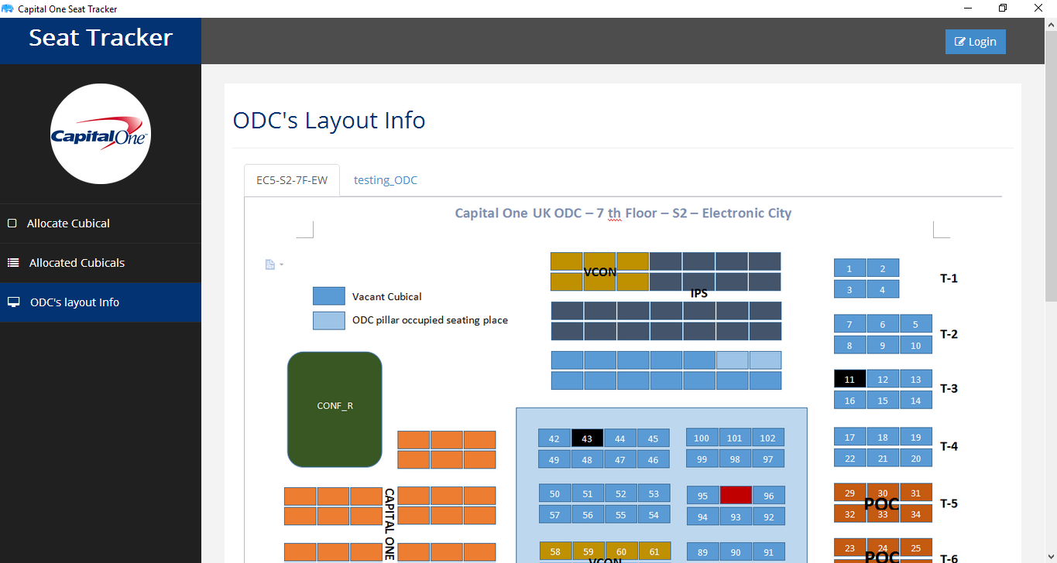
8. ODC layouts can be displayed in the “ODC’s layout info” tab as shown below.
Notes:
Blank slide or a freeform slide you may use this to insert or show screenshots etc
If content is added in this slide you will need to use bulleted text

Slide 9
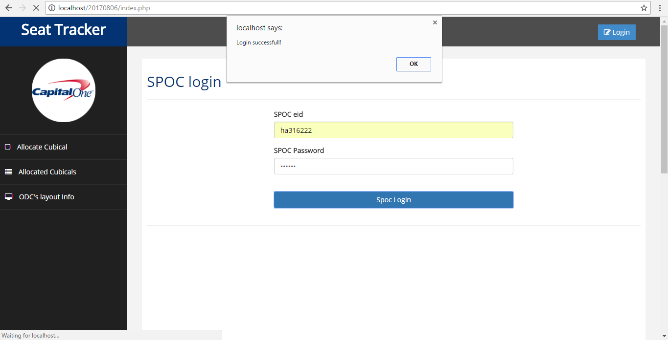
9. Below is the SPOC login page; for every ODC one or two members can be a SPOC. And he alone can control the employees data in his ODC.
Notes:
Content Slide: This is usually the most frequently used slide in every presentation.
Use this slide for Text heavy slides. Text can only be used in bullet points
Title Heading – font size 30, Arial bold
Slide Content – Should not reduce beyond Arial font 16
If you need to use sub bullets please use the indent buttons located next to the bullets buttons in the tool bar and this will automatically provide you with the second, third, fourth & fifth level bullet styles and font sizes
Please note you can also press the tab key to create the different levels of bulleted content

Slide 10
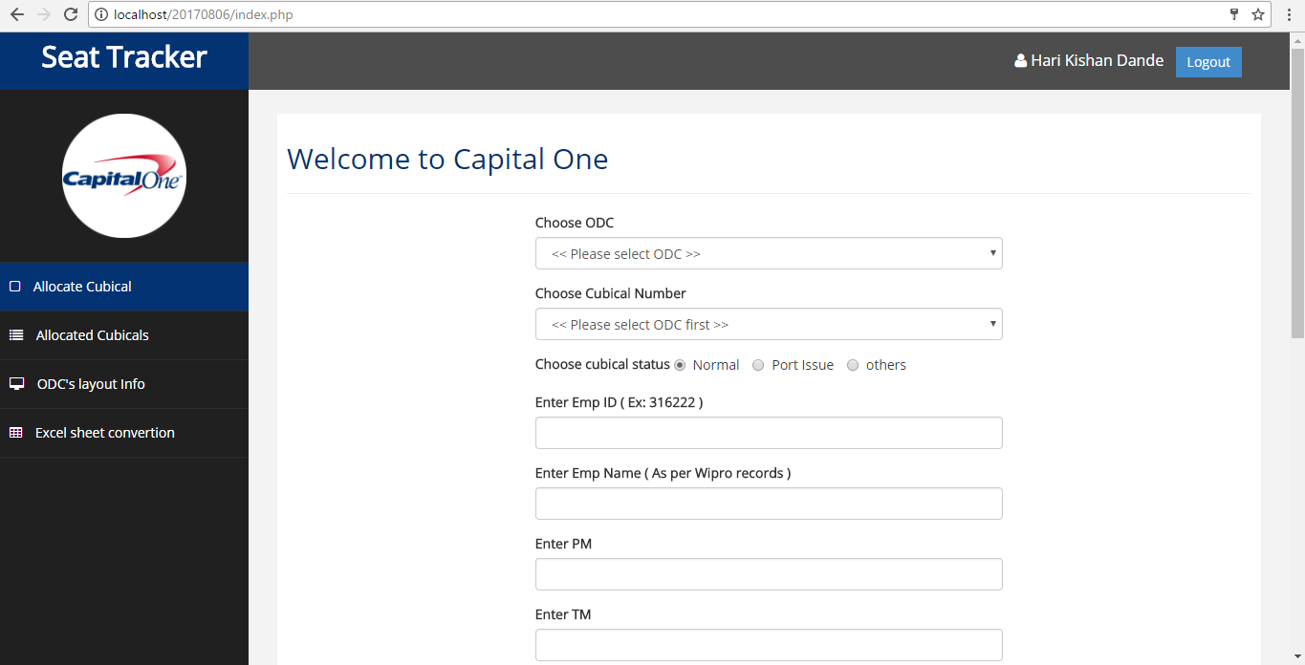
10. SPOC can also allocate cubicles in case if employees were not able to allocate cubical by them self.
Notes:
Blank slide or a freeform slide you may use this to insert or show screenshots etc
If content is added in this slide you will need to use bulleted text

Slide 11
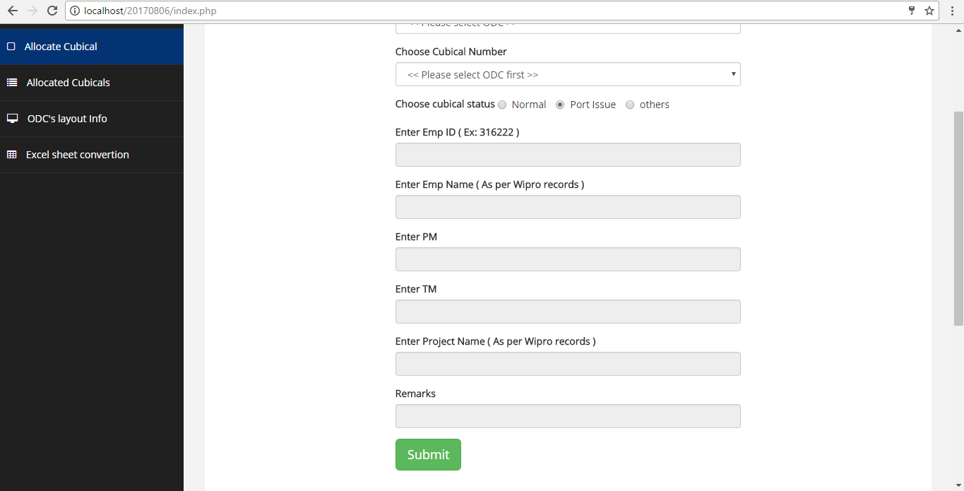
11. If any cubical is having port issue, SPOC can highlight it in the application as PORT ISSUE in order to avoid any employee to occupy the same cubical with port issue; “below mandatory fields are disabled as the cubical is having port issue”.
Notes:
Content Slide: This is usually the most frequently used slide in every presentation.
Use this slide for Text heavy slides. Text can only be used in bullet points
Title Heading – font size 30, Arial bold
Slide Content – Should not reduce beyond Arial font 16
If you need to use sub bullets please use the indent buttons located next to the bullets buttons in the tool bar and this will automatically provide you with the second, third, fourth & fifth level bullet styles and font sizes
Please note you can also press the tab key to create the different levels of bulleted content

Slide 12
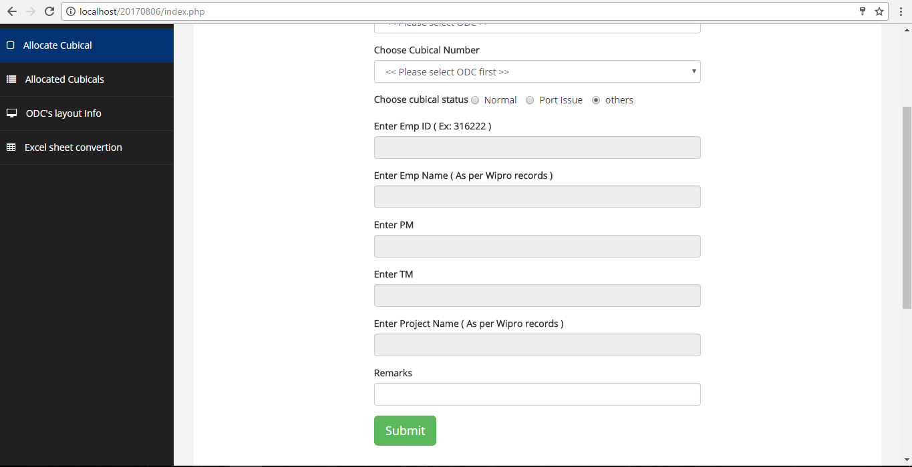
12. When we have to block some cubicles for any future requirement, we can choose “Others” as a category; here below “Remarks” field is mandatory.
Notes:
Blank slide or a freeform slide you may use this to insert or show screenshots etc
If content is added in this slide you will need to use bulleted text

Slide 13
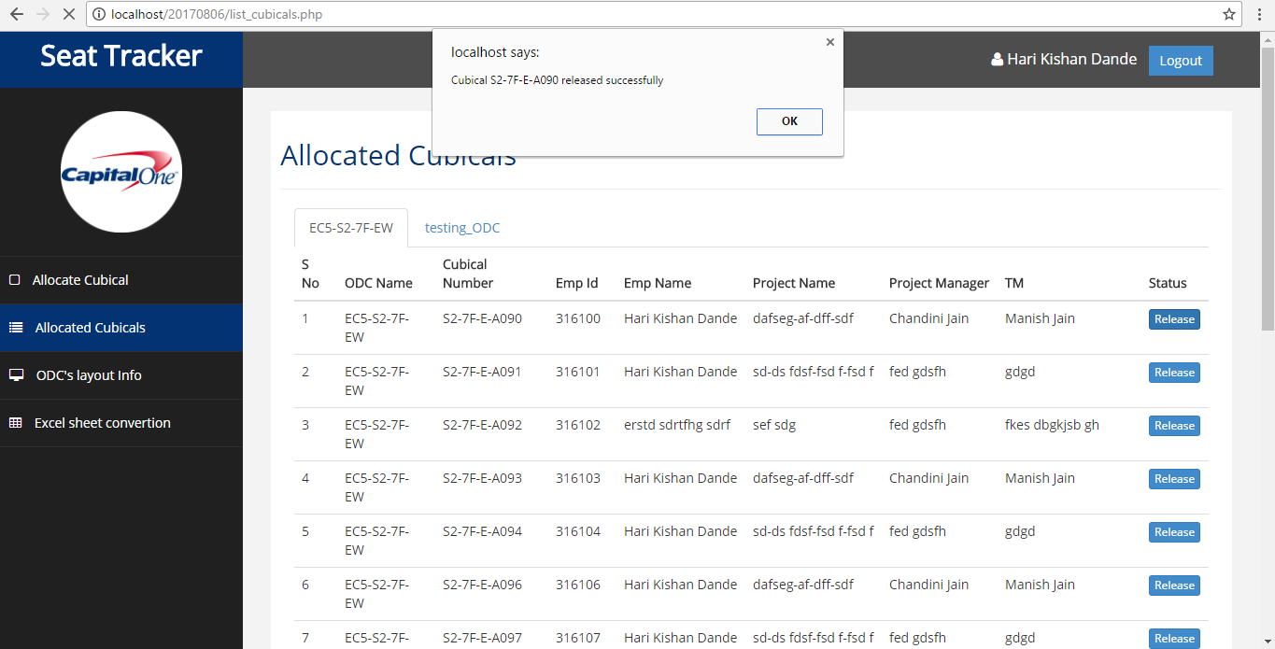
13. Below ‘release’ option is available to SPOC for his ODC to release any cubical that has been wrongly entered or for employees movement etc.
Notes:
Content Slide: This is usually the most frequently used slide in every presentation.
Use this slide for Text heavy slides. Text can only be used in bullet points
Title Heading – font size 30, Arial bold
Slide Content – Should not reduce beyond Arial font 16
If you need to use sub bullets please use the indent buttons located next to the bullets buttons in the tool bar and this will automatically provide you with the second, third, fourth & fifth level bullet styles and font sizes
Please note you can also press the tab key to create the different levels of bulleted content

Slide 14
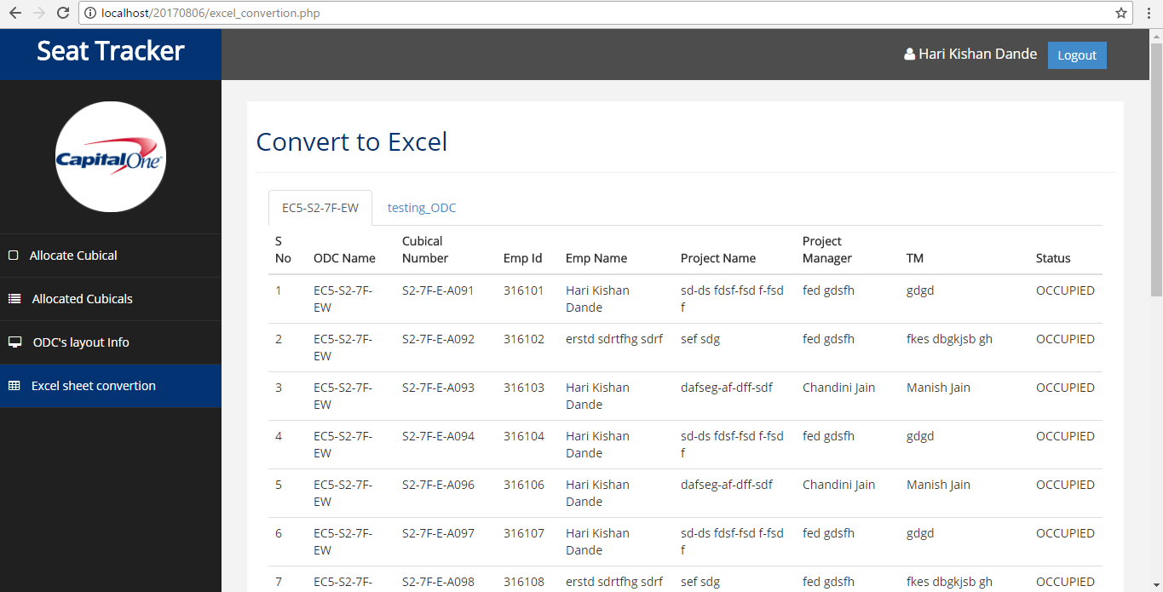
14. “Excel sheet conversion” is a special tab which converts the ODC records into an excel sheet, SPOC alone can do this.[slide 1]
Notes:
Content Slide: This is usually the most frequently used slide in every presentation.
Use this slide for Text heavy slides. Text can only be used in bullet points
Title Heading – font size 30, Arial bold
Slide Content – Should not reduce beyond Arial font 16
If you need to use sub bullets please use the indent buttons located next to the bullets buttons in the tool bar and this will automatically provide you with the second, third, fourth & fifth level bullet styles and font sizes
Please note you can also press the tab key to create the different levels of bulleted content

Slide 15
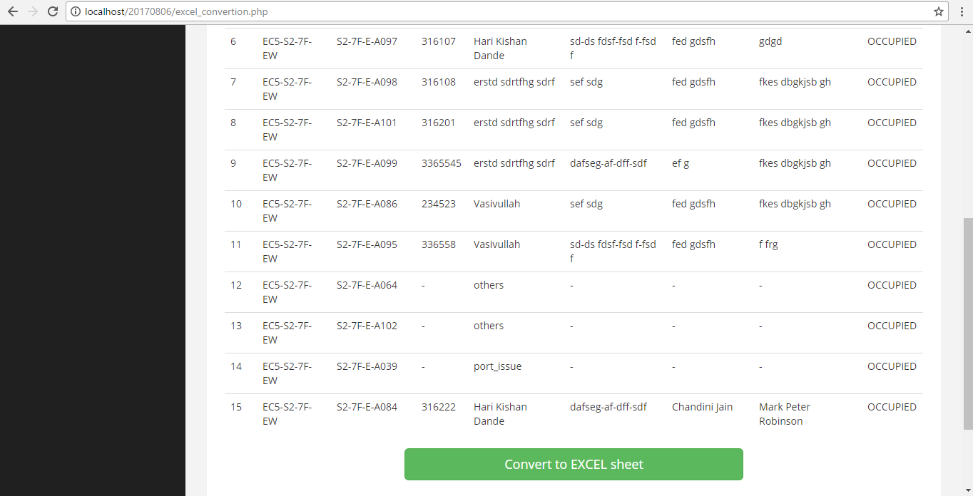
15. [slide 2]
Notes:
Blank slide or a freeform slide you may use this to insert or show screenshots etc
If content is added in this slide you will need to use bulleted text

Slide 16
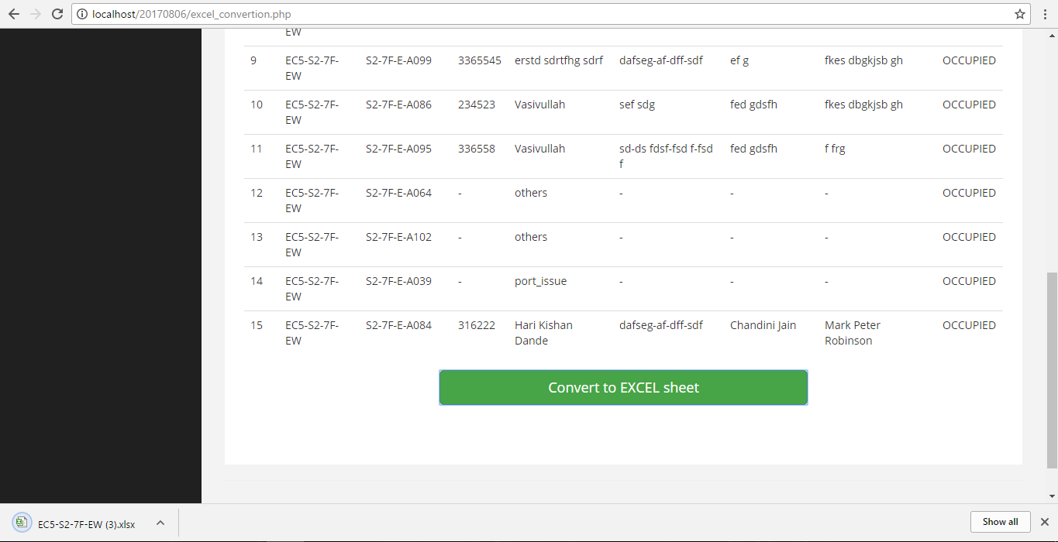
16. As I was a SPOC to a ODC, I was able to convert the data into Excel sheet, you can observer the sheet downloaded at the bottom.
Notes:
Blank slide or a freeform slide you may use this to insert or show screenshots etc
If content is added in this slide you will need to use bulleted text

Slide 17
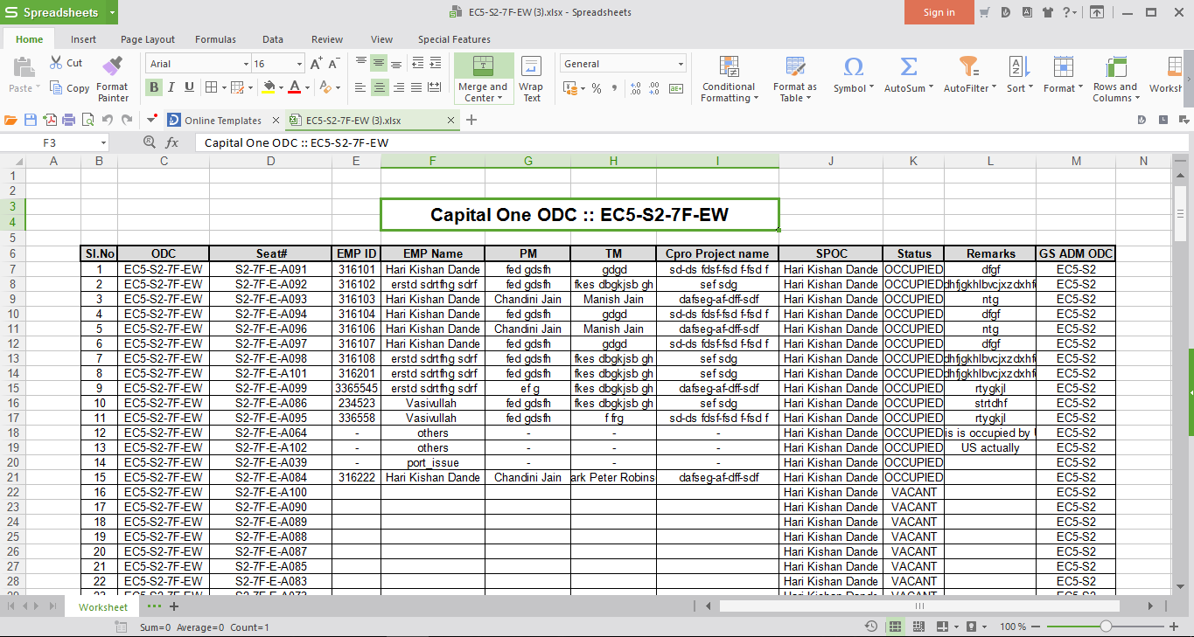
17. Below is the downloaded seat tracker sheet which has all the employee occupancy and vacant information. [slide 1]
Notes:
Content Slide: This is usually the most frequently used slide in every presentation.
Use this slide for Text heavy slides. Text can only be used in bullet points
Title Heading – font size 30, Arial bold
Slide Content – Should not reduce beyond Arial font 16
If you need to use sub bullets please use the indent buttons located next to the bullets buttons in the tool bar and this will automatically provide you with the second, third, fourth & fifth level bullet styles and font sizes
Please note you can also press the tab key to create the different levels of bulleted content

Slide 18
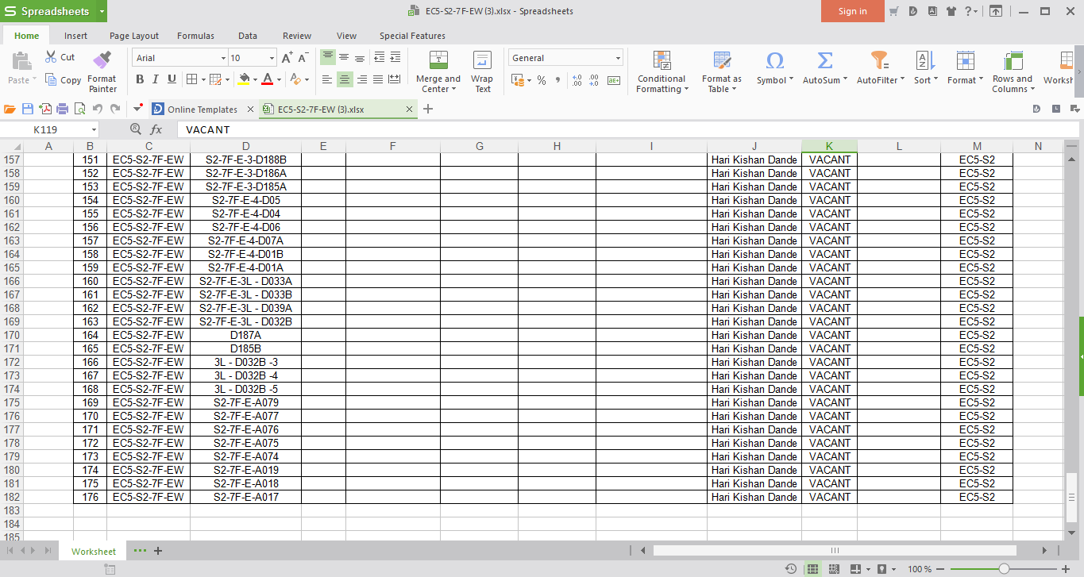
18. [slide 2]
Notes:
Blank slide or a freeform slide you may use this to insert or show screenshots etc
If content is added in this slide you will need to use bulleted text

Slide 19
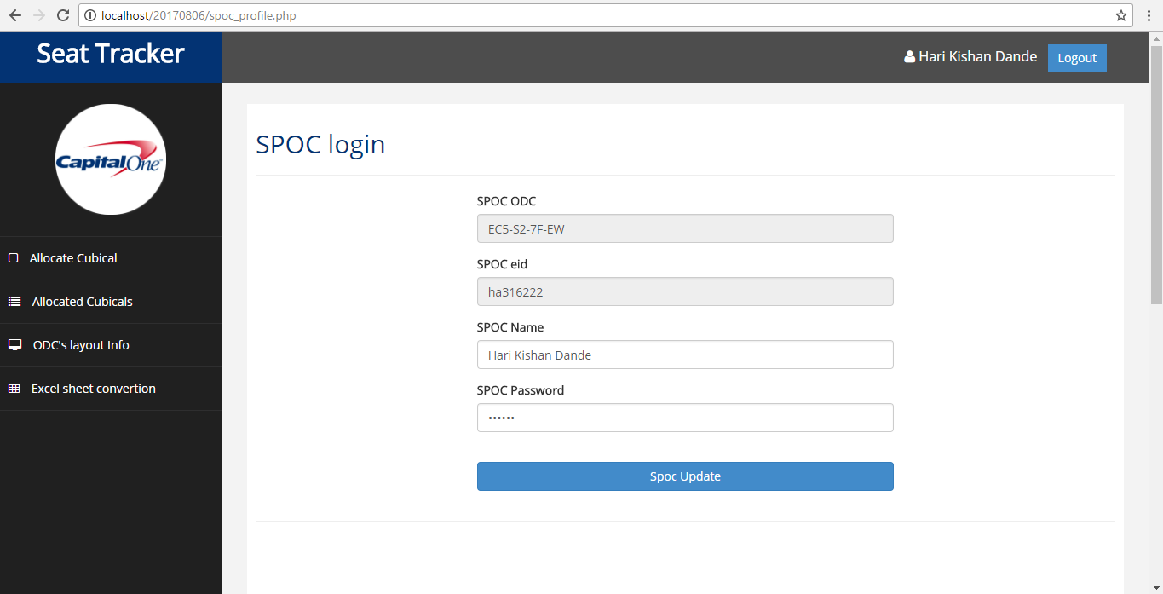
20. This is a SPOC profile page; In here SPOC member can change his name and password but he/she can’t change his ODC and Eid details.
Notes:
Content Slide: This is usually the most frequently used slide in every presentation.
Use this slide for Text heavy slides. Text can only be used in bullet points
Title Heading – font size 30, Arial bold
Slide Content – Should not reduce beyond Arial font 16
If you need to use sub bullets please use the indent buttons located next to the bullets buttons in the tool bar and this will automatically provide you with the second, third, fourth & fifth level bullet styles and font sizes
Please note you can also press the tab key to create the different levels of bulleted content

Slide 20
Note:
If we don’t get sufficient approvals for using the logos I have shown in the slides, we can easily remove them before rolling-out actual application to the users.

Slide 21
Thank you
Notes:
Thank you slide:
Thank you– font size 30, Arial Bold
Name & Designation – font size 18, Arial normal
Your/contact email id – font size 18, Arial normal

